Slide 1

Cyber Insecurity:
Reclaiming Personal Privacy in the Information Era
Presenter: Alexander Ottewell
Faculty Mentor: Nery Chapeton-Lamas

Slide 2
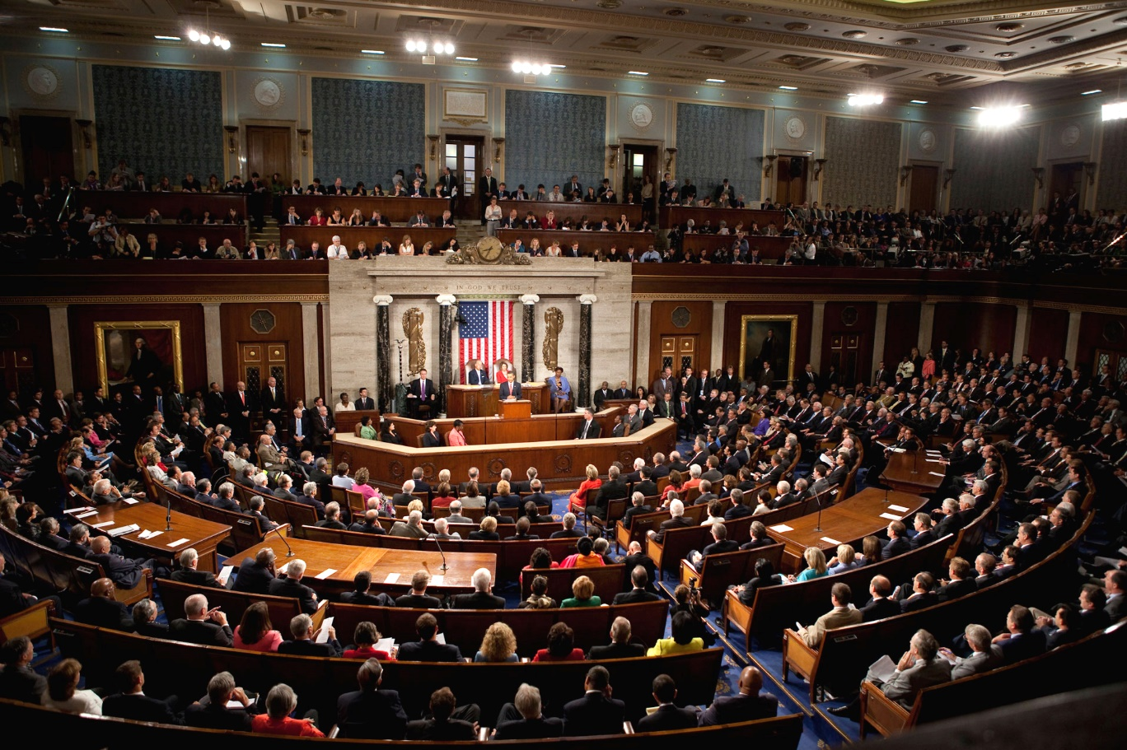
On March 28, The House of Representatives passed a resolution overturning an Obama-era FCC rule.
It required providers to get permission before sharing customers’ browsing history.
In result, AT&T, Comcast, and others will be able to sell your information to the highest bidder.

Slide 3
Acknowledging the Threat.
In 1990 the Internet took on the form we recognize today.
It is a 27 year old network of land cables, servers and more recently, cloud computing storage facilities.
This also means that said network can be breached and hacked with malicious intent.

Slide 4
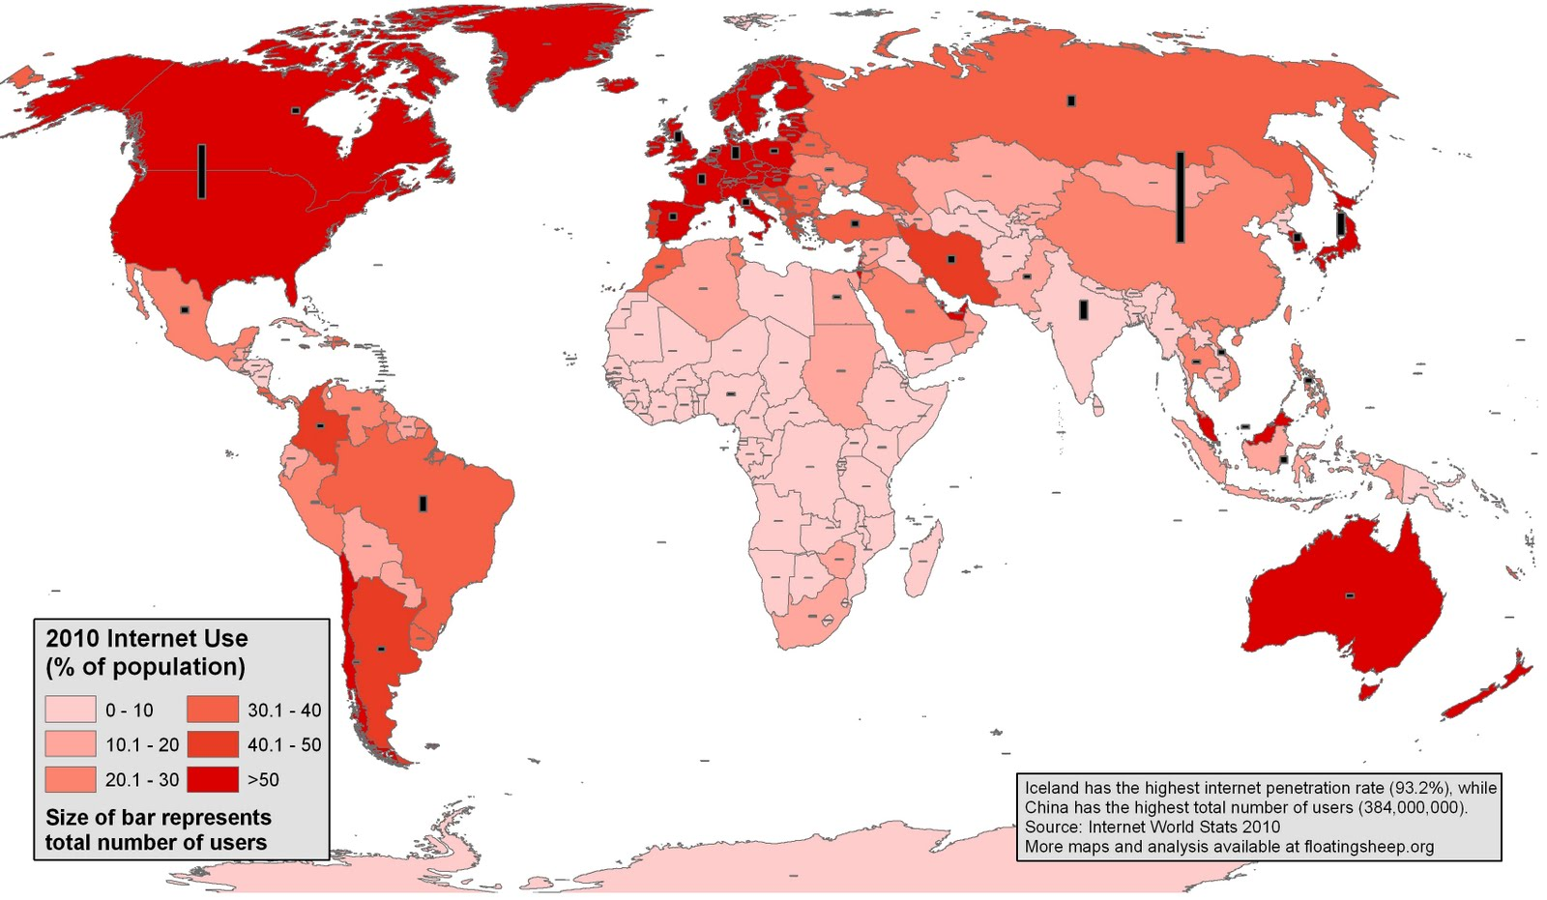
Acknowledging the Threat.
Every day, billions of people around the world use the Internet.
Also known as “users”, people send and store personal data on this global network.
In order for this network to grow and thrive, users must continue to trust that their privacy will be protected.

Slide 5

Acknowledging the Threat.
Unfortunately, this is not the case.
NTIA’s most recent data analysis shows that Americans are increasingly concerned about online security.
These concerns are prompting many Americans to limit their online activity, according to the U.S. Census Bureau in 2015.

Slide 6
Acknowledging the Threat.
Perhaps the most direct threat to maintaining consumer trust is negative personal experience.
Nearly 19 million households reported an online security breach during the 12 months prior to the survey.
Security breaches appear to be more common among the most intensive Internet-using households.

Slide 7
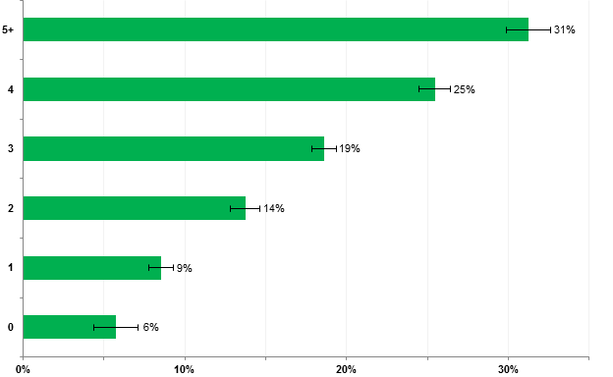
Figure 1: Households Reporting Online Security Breaches by Number of Different Types of Devices Used, Percent of Households with Internet Users, 2015
ntia.doc.gov
Number of Devices
Percent of Reported Breaches

Slide 8
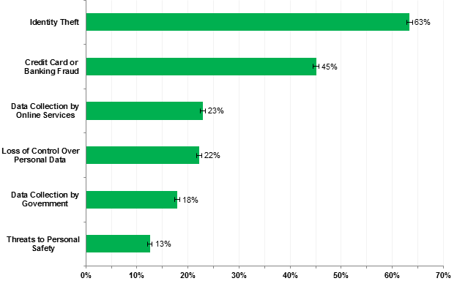
Figure 2: Major Concerns Related to Online Privacy and Security Risks, Percent of Households with Internet Users, 2015
ntia.doc.gov
Type of Concern
Percent of Households

Slide 9
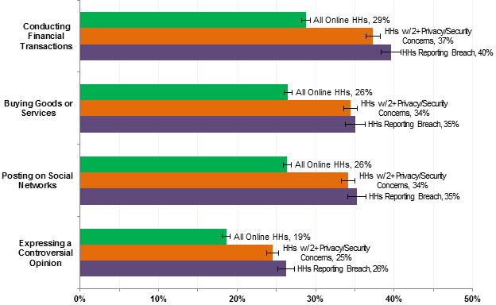
Figure 3: Online Activities Avoided Due to Privacy or Security Concerns by Selected Groups, Percent of Households (HHs) with Internet Users, 2015
ntia.doc.gov
Avoided Activities
Percent of Households

Slide 10
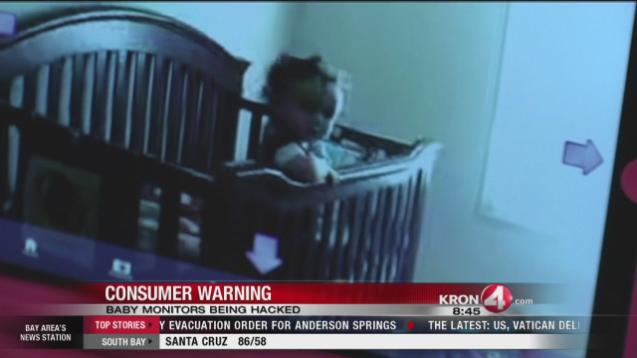
For Example:

Slide 11
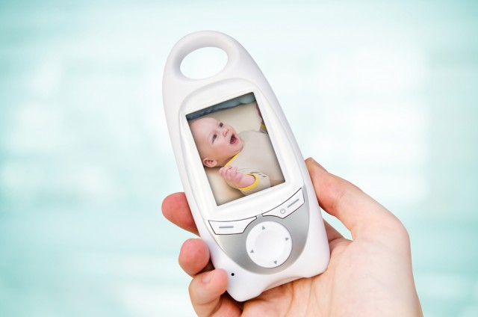
The term “Internet of Things” (IoT) is used to describe a galaxy of wildly different devices, from twenty dollar children’s toys to airliners that cost hundreds of millions of dollars.
This is relevant today, as employees increasingly blur the lines between home and business networks.
NOT SAFE!

Slide 12
The percentage of people working from home continues to rise.
This trend is increasingly common across all genders, ages, and family statuses.
The presence of insecure devices constitutes a threat to the device, its data and the network.

Slide 13

The share of workers grew from 19 percent in 2003 to 24 percent in 2015.
-U.S. Bureau of Labor Statistics

Slide 14
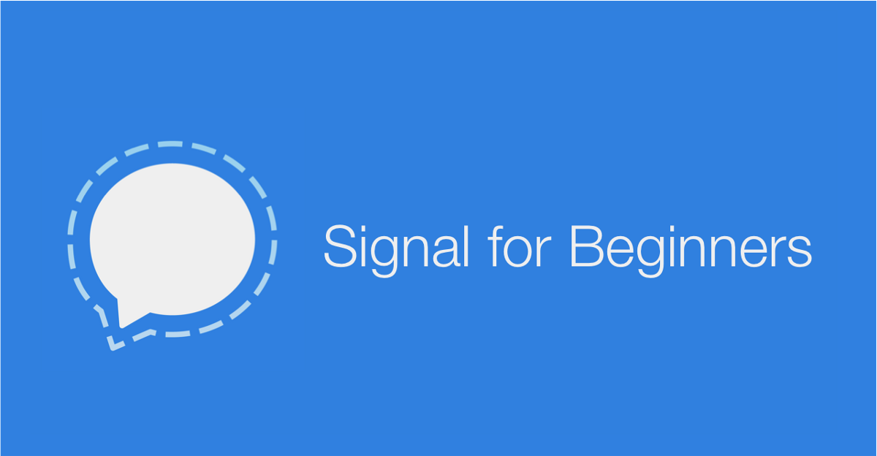
Reclaiming Personal Privacy.
The first step that anyone could take is to encrypt their phone calls and their text messages.
It can be through the smartphone app Signal, by Open Whisper Systems.
It’s free, and can be downloaded immediately.

Slide 15
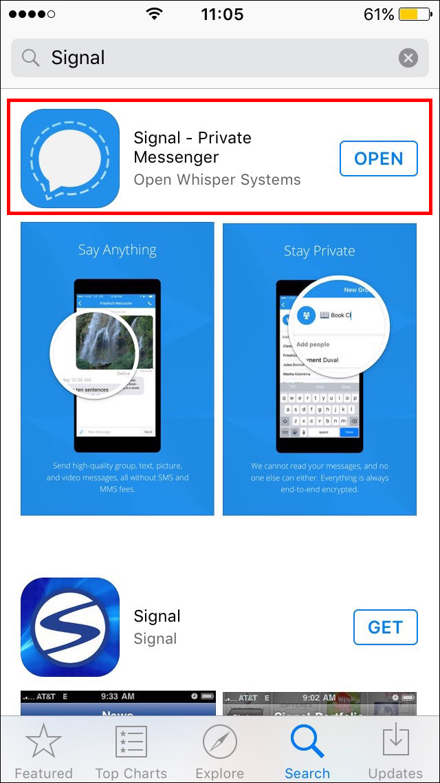
Simply download the app.
Provide your telephone number and access to your contacts list.

Slide 16
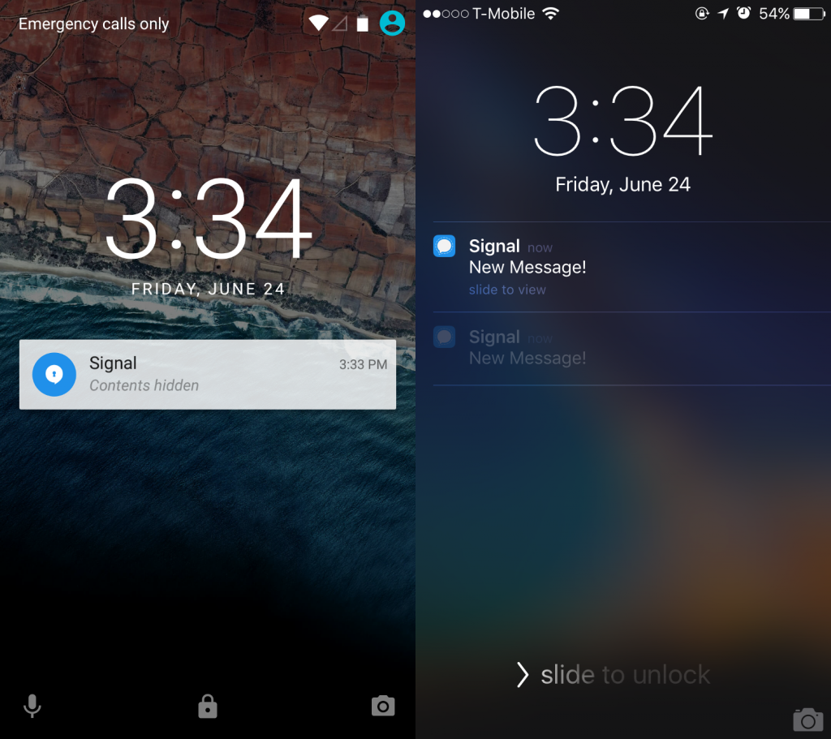
Receive a confirmation code.
Enjoy your encrypted communication.

Slide 17

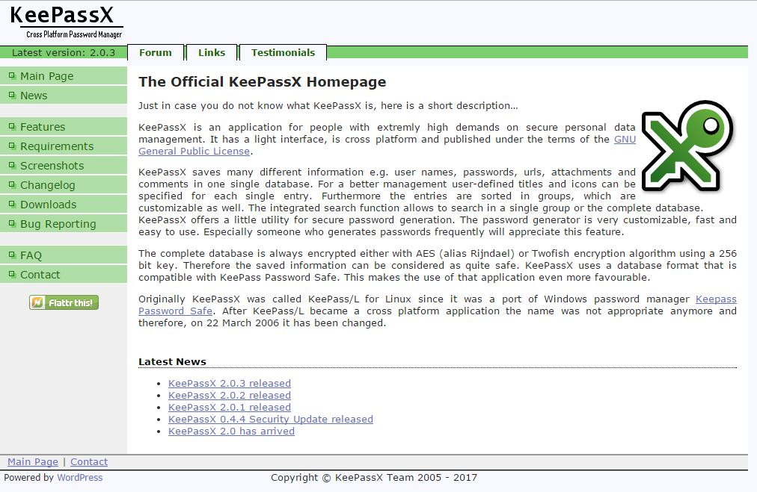
Reclaiming Personal Privacy.
Use a password manager.
One of the main things that gets people’s private information exposed are data dumps.
A password manager allows for creation of unique passwords for every site.
[The password manager KeePassX is free, open source, cross-platform, and never stores anything in the cloud.]
Requires Linux!

Slide 18
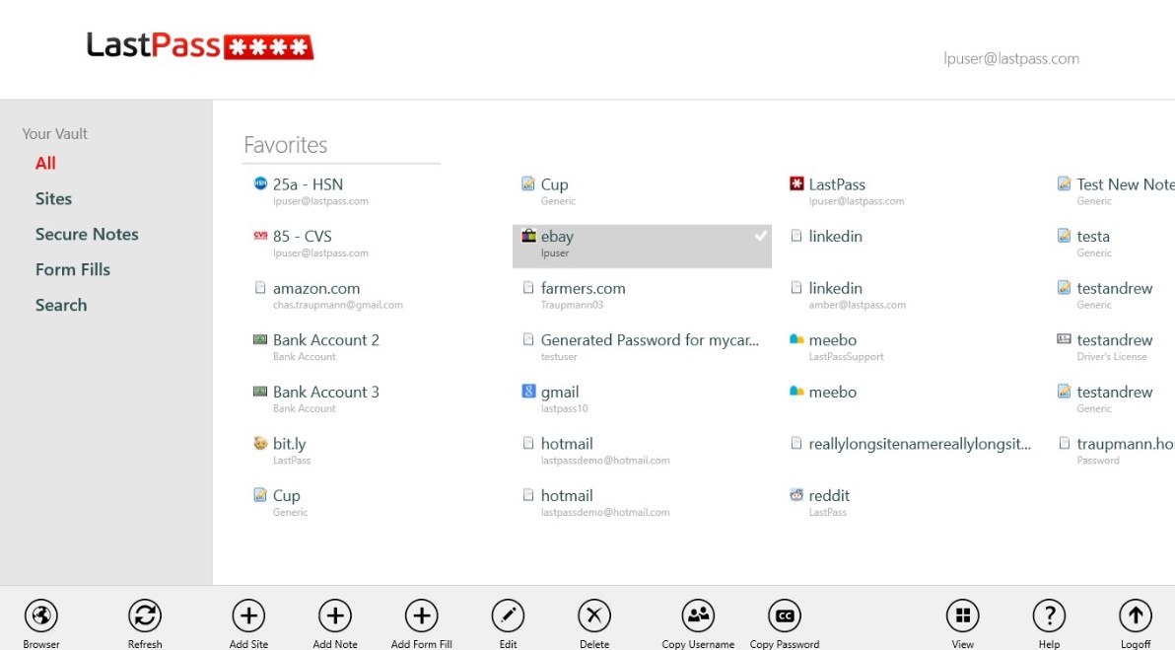
Reclaiming Personal Privacy.
Last pass is the most widely used password manager on the planet.
Can access offline.
More user friendly. Click, setup and done.

Slide 19
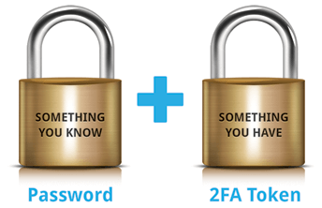
Reclaiming Personal Privacy.
Implement two-factor authentication.
Allows the provider to send you a secondary means of authentication — a text message for example.
An attacker needs both your password and a physical device, like your phone, to login to your account.
Gmail, Facebook, Twitter, Dropbox, GitHub, Battle.net support two-factor authentication.

Slide 20


Slide 21
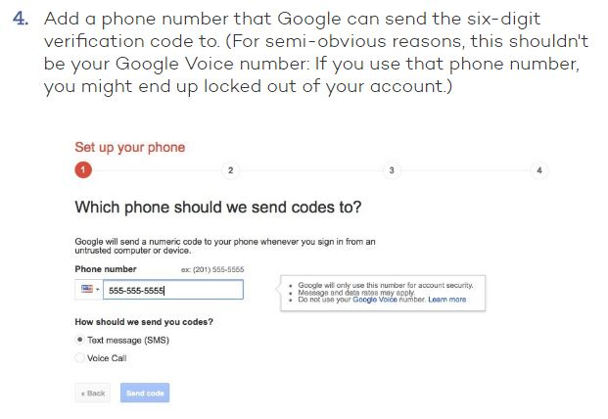

Slide 22
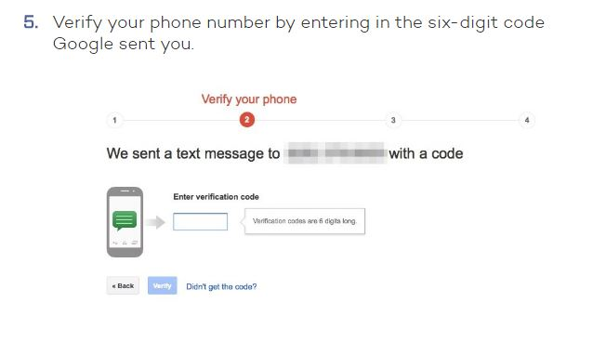

Slide 23
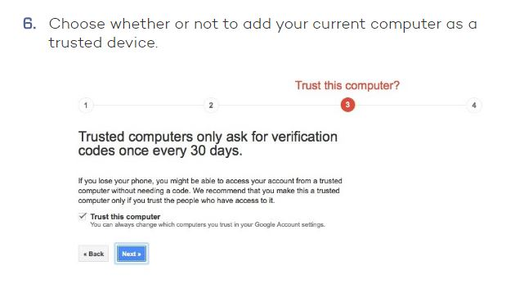

Slide 24
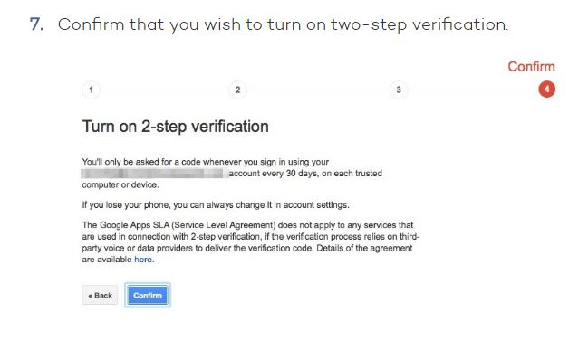

Slide 25

Finally, we should armor ourselves using systems we can rely on every day.
Security doesn’t need to be an extraordinary lifestyle change.
It should be invisible, it should be atmospheric, it should be something that happens painlessly and effortlessly.

Slide 26
Questions?

